Slide 1
Server Platform
Presented by: Andrei Warkentin (Intel), Drew Jones (Ventana), Server Platform TG
RISC-V Summit ‘24 München

Slide 2
TG Info
Charter https://github.com/riscv-admin/server-platform
Spec https://github.com/riscv-non-isa/riscv-server-platform
JIRA https://jira.riscv.org/browse/RVS-1781
Email tech-server-platforms@lists.riscv.org
Drive https://drive.google.com/drive/folders/10_AsTBkkU-egrcF4Z2G2ae-Jk4ZeypY6
Meetings Bi-Weekly on Monday, @ 6 PM CEST (9 AM PST)
Chairs Andrei Warkentin (Intel), Drew Jones (Ventana)
Contributions welcome!
Raise issues on GitHub
… anything too controversial in terms of GH discussion probably deserves an email thread!
Raising PRs (or PRs for issues) is an even better mechanism (provide a solution, even if it isn’t the best solution, is miles better than talking about a problem)
Meetings generally about decisions, not discussion (prep via email!)

Slide 3
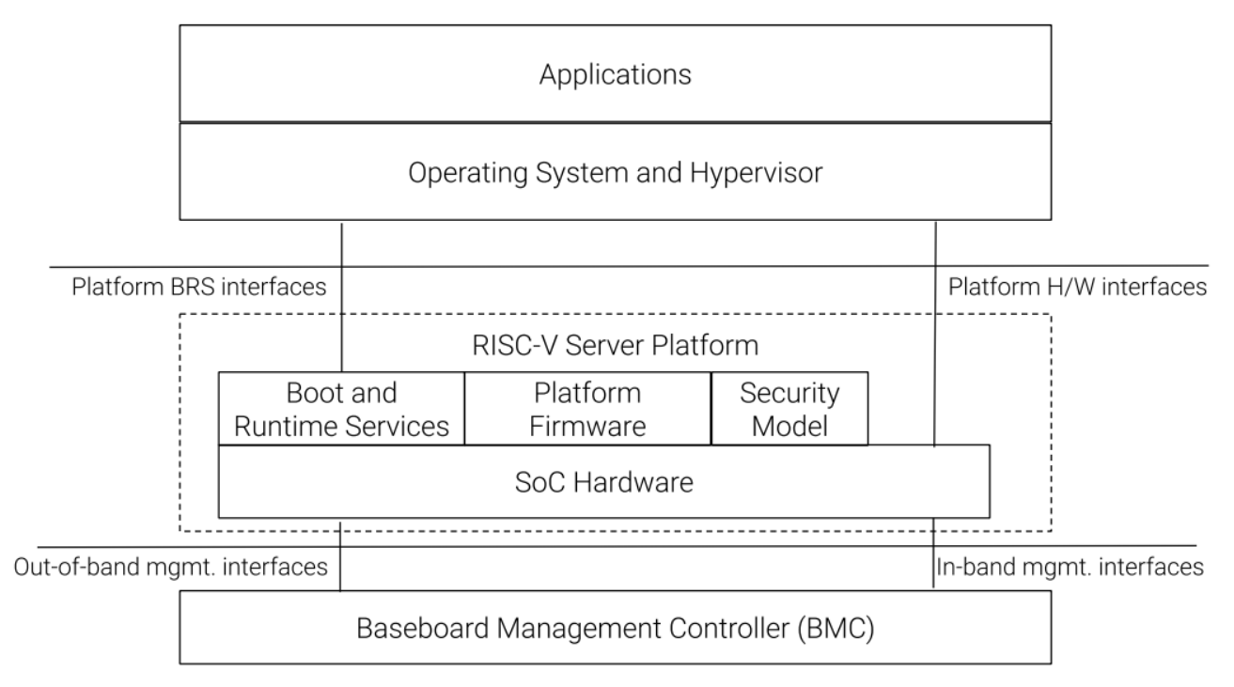
Server Platform specification
Enables a single binary OS image distribution model.
Ties together hardware (SoC), firmware (BRS) and security specifications:
Standardized set of SW capabilities.
OS loader interfaces, hardware description mechanisms, etc.
Standardized set of HW capabilities.
harts, timers, interrupt controllers, PCIe root complexes, RAS, QoS, in-band mgmt., etc.)
Common security model.
A server is a computing system that is designed to manage and distribute resources, services and data to other computers or devices on a network. “It serves” or provides information or resources upon request. Such systems are designed to operate continually and have a higher degree of requirements on RAS, security, quality of service, etc.

Slide 4
Server Platform TG charter
The Server Platform Task Group shall define a specification for a standardized set of hardware and software capabilities, that portable system software (such as operating systems and hypervisors) can rely on being present in a RISC-V server platform.
https://github.com/riscv-admin/server-platform/blob/main/charter.adoc
The produced specification will tie together the many hardware and software requirements for a server platform, many of which are defined in detail by other RISC-V specs, such as:
ISA Profiles
Boot and Runtime Services
Server SoC
Platform security Model
Where applicable, the produced specification shall reference relevant industry standards. The intent is that most of the normative content is developed by other TGs and that the Server Platform Specification is the document that binds everything together and provides a practical architectural guide to achieve the stated goals. It is expected that the Server Platform Specification will add additional (refining) requirements in relevant areas.

Slide 5


TG deliverables - specifications
Server Platform Requirements Specification 1.0
Server Platform Test Specification 1.0
Server Platform Requirements Specification
Standardized set of HW, SW and security capabilities that OS/Hypervisors can rely on being present in a Server Platform
Server Platform Test Specification
Provide hardware/firmware developers and system integrators with a set of tests to verify compliance to the requirements specification

Slide 6
Relationship with other specs
Server SoC Requirements Specification 1.0
Server SoC Test Specification 1.0
BRS Requirements Specification 1.0
BRS Test Specification 1.0
ISA profile
RISC-V Platform Security Model
Additional server-specific refinements/mandates on incoming specifications that are server specific.
Not point in time - expected to evolve
Standards - DMTF, CXL, PCI-SIG, etc.
New usages, ISA, non-ISA
Evolution cadence - updated periodically
stay up to date with the evolution of dependent specs
meet the evolving market requirements
Server Platform Specification 1.0
Server Platform Test Specification 1.0
Notes:
Clarify that actual spec ratification timeline depends on ratification timelines for the dependencies.

Slide 7
Key Milestones
Jira Spec https://jira.riscv.org/browse/RVS-1781
Key Milestones | Date
Plan Approval | 6/12/2024
Internal Review Start | 9/10/2024
Architecture Review Request | 10/10/2024
Freeze Milestone | 11/16/2024
Public Review Start | 12/17/2024
Ratification-Ready Milestone | 11/23/2024
TSC Approval | 01/15/2025
Board Ratification | 01/30/2025

Slide 8
Is this doable?
Depends on BRS, Server SoC and RISC-V Platform Security Model.
The spec is largely an exercise in integration, tying to together multiple specs for a particular use-case.
We have a good set of SiPs and OSVs represented, many with prior x86 and AArch64 SystemReady experience.
The use-case is well understood with a clear benefit for standardization and significant industry activity to define/refine.
Call to action to OSVs
Not just Linux?
Public activity

Slide 9
Living and evolving specification
Evolving specification. There’s no “perfect v1” to dwell on.
RISC-V SoC, RISC-V BRS, Security Model
Industry standards - DMTF, OCP, CXL, PCI-SIG, etc.
New usages
RISC-V ISA profiles
RISC-V non-ISA specification.
Need to identify right cadence for evolving, and sync this with dependent TGs (BRS, SoC, etc).
Expect to follow similar cadence as ISA profiles.

Slide 10
Where are we today?
RVA_XXX - Hart requirements (moved from Server SoC).
HSOC_XXX - SoC requirements (building on Server SoC).
HPER_XXX - Additional peripheral requirements.
FIRM_XXX - Server firmware requirements (building on BRS).
SEC_XXX - Security requirements (on top of Server SoC and BRS).
A good set of issues raised over at https://github.com/riscv-non-isa/riscv-server-platform/issues.

Slide 11
Proof-of-concept and RISC-V Tests
Proof-of Concept
Builds on top of BRS, Server SoC PoCs.
Software Support (OS, RTOS, Hypervisor, etc.)
Piggy-backs on existing BRS, Server SoC-related work.
Simulator Support
QEMU: Server SoC platform + BRS-I UEFI.
Tests
Builds on same test framework as BRS and Server SoC, incorporates BRS and Server SoC test suites.

Slide 12
BACKUP

Slide 13
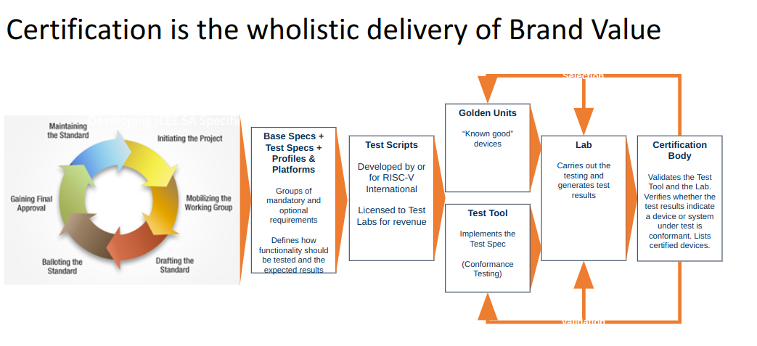
Path to Certifications?
Server Platform req. & test spec. ⊃
(Server SoC req. & test spec. ∪
BRS req. & test spec. ∪
Security Model ∪
ISA profiles)
Server Platform Test Suite ⊃
(Server SoC Test Suite ∪
BRS Test Suite)
Notes:
Certification Steering Committee

Slide 14
Server Platform test suite
Server Platform Test Suite
Server SoC Test Suite
BRS Test Suite
Linux
Common/Shared infrastructure with SoC/BRS test suite
BRS-I UEFI
ACPI
SMBIOS
SBI
QEMU virtual platform (server-soc)
Server Platform Test specification is to form the basis of a test suite
Not a deliverable from the TG
Plan to develop as a RISE project (like the BRS and Server SC test suite)
Includes dependent TS

Slide 15
Server Platform Test specification
Start Here for first version
Over a few versions trend here
Feature exists
Some proofs of “working”
Mostly works as expected
Fully verified and has no known bugs
Goal (for now) is not to fully verify the implementation correctness
For first version may want to look for existence proofs where possible
In some cases the first version may also do some proof of working as expected

